Slide 1


PROGRAMMATIC
& ADVERTISING PLANNING
www.coccoc.com

Slide 2
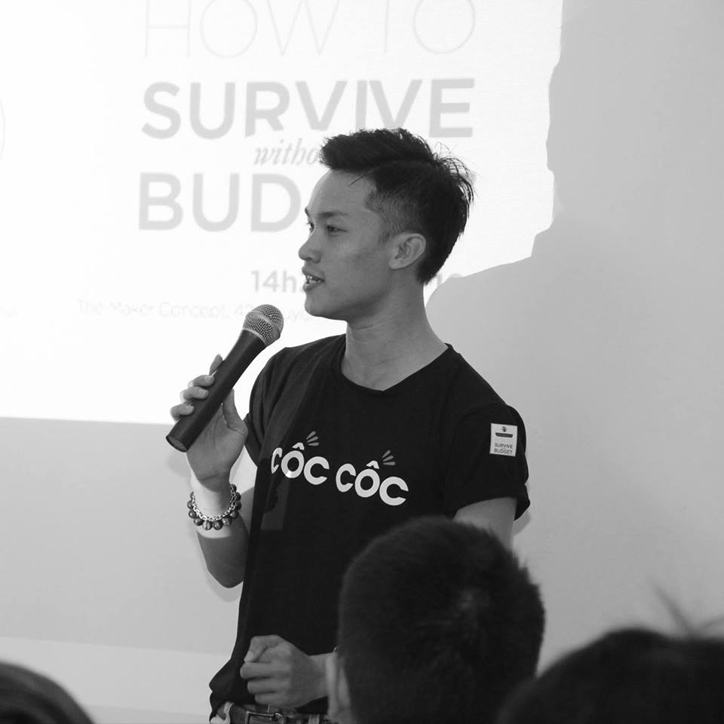


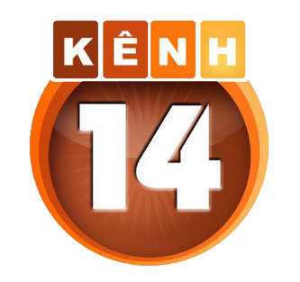
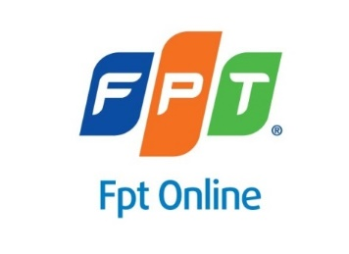
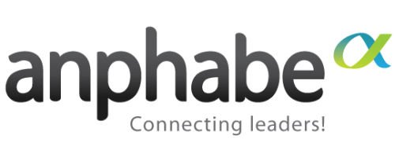


Nguyễn Thành Long
Head of Marketing School Cốc Cốc
https://www.facebook.com/HocvienMarketingCocCoc
Email: Orlando@coccoc.com
Skype: Orlando.han

Slide 3
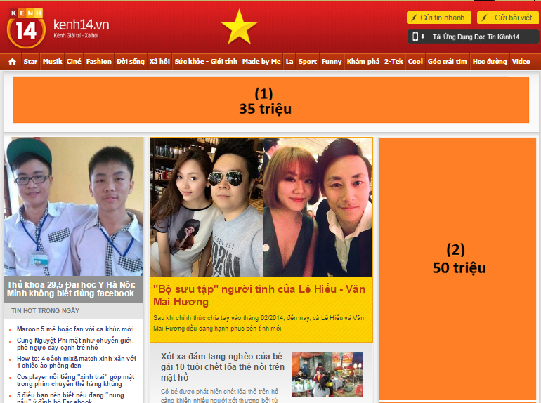
GIẢI TOÁN?

Slide 4
GIẢI TOÁN?
CPD = 50.000.000
VND/tuần
Chia sẻ 3
Visits:
101.122.481/tháng
CTR: 0.06%

Slide 5
CPC/ CPM
Cost per Click
tính chi phí theo lượt click
Cost per Mile
tính chi phí theo 1,000 lượt hiển thị

Slide 6
CTR: Click through rate
Chỉ số click chuột vào quảng cáo
Clicks
x 100%
CTR =
Impressions

Slide 7
Đặt quảng cáo 1 tuần: 25.280.620 visits
Chia sẻ 3 => Visits = 8.426.873/tuần
CTR = 0.06%
Clicks = 5.000,1238
CPC = 50.000.000/5.000,1238 = 10.000

Slide 8
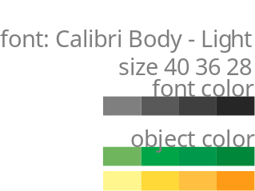
ADNETWORK RA ĐỜI

Slide 9
Adnetwork có thể làm được gì?
Targeting
Ad serving
Tracking
Management & Report

Slide 10
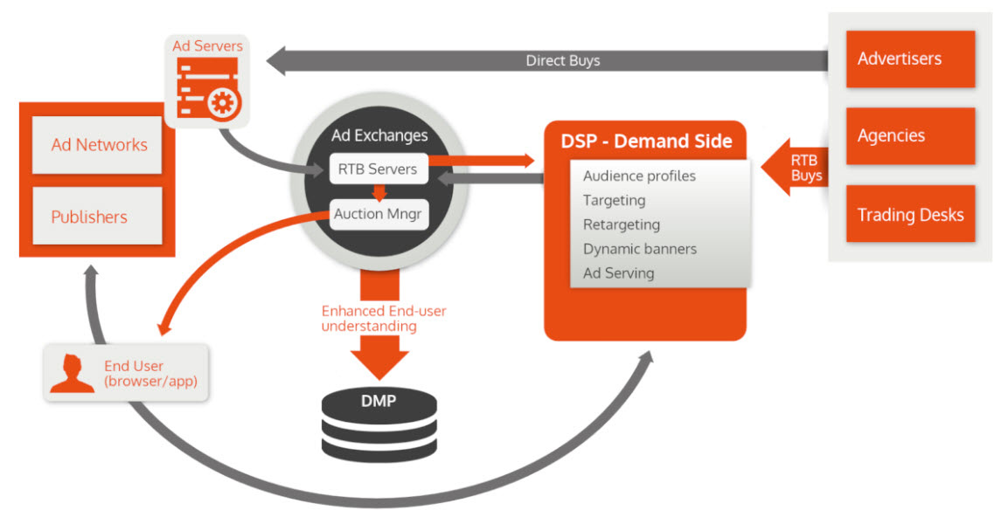

Slide 11


What Is Programmatic?
Q: What is Programmatic?
Programmatic is the process
The Demand Side Platform (DSP) is the Machine to buy Ads
A: It’s using machines to buy ads, basically
Notes:
So everyone in this room have probably heard word programmatic, what does it mean? When applied to media programmatic is essentially using machines to buy digital ads. What I like to stress here is that programmatic is the process of ad buying, it’s not a media, you don’t buy programmatic. Paired with programmatic, there are other words like DSP, which is the technology platform that enables programmatic ad buying. I’m not going to talk too much about thi

Slide 12

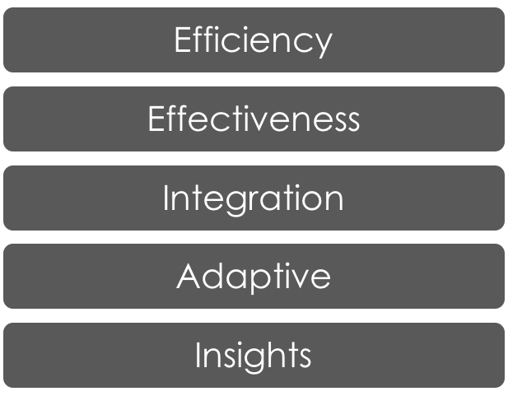

Why Programmatic?
Leverages automated data driven buying technology to improve media buying
Automation of manual processes by machines
Data-driven, more intelligent marketing and learning
Notes:
So what are the benefits of programmatic? With automation and the data-driven approach, first it can increase media buying efficiency thru technologies like cross media frequency capping. It can also increase the effectiveness of our ads thru a higher target reach %. Programmatic also allows us to integrate all the data that currently sits in silos, for example website data, CRM data, and ad data. Being more adaptive has always been a goal for Mindshare, programmatic enables to optimize campaigns in real time vs. a static spot plan. And lastly, we can gain more insights on our consumers from all the data that we gather

Slide 13
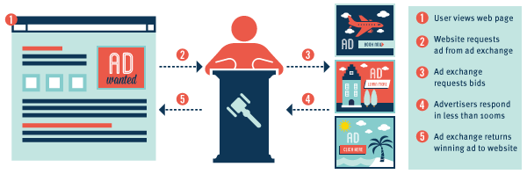

Slide 14
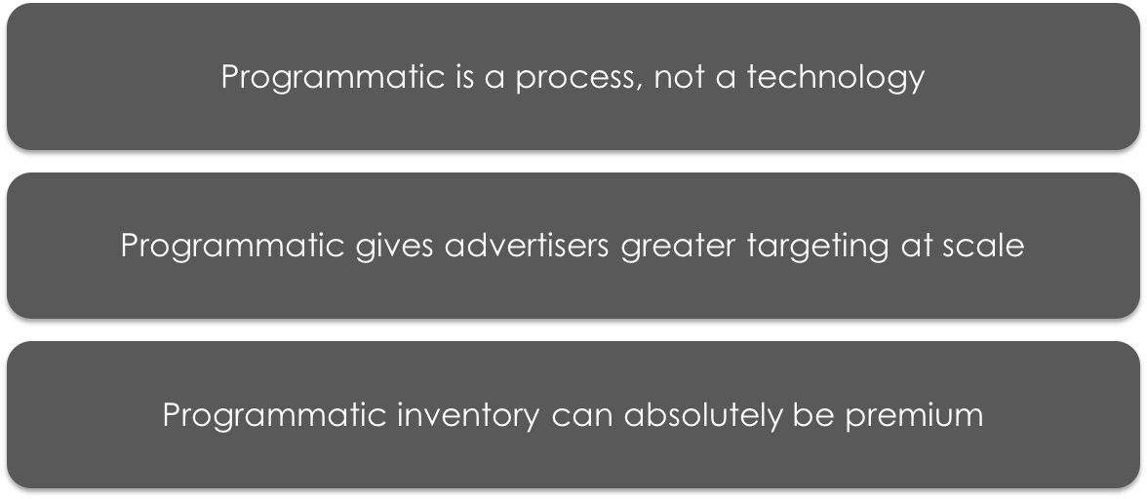
In Summary…
Notes:
So the key takeaways from this section are first, programmatic is a process not a technology or a media. second, programmatic gives advertisers greater targeting at scale, and third programmatic inventory can absolutely be premium.

Slide 15
THANK YOU
www.coccoc.com

